Slide 1
CASE STUDY
Name- Aryan Meshram
TEAM 6

Slide 2
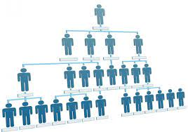
Business Problem
1. AI technology and machine learning plays a crucial role in today's corporate world and reduces time and effort of the employees.
Organization Structure Unit - The system hierarchy or business model has a great impact not only on planning of new products but also lead specialization of work, which will help gathering the right members. This will help in search of the user.

Slide 3
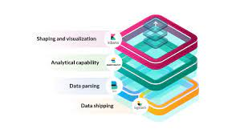
Elastic Stack - It evaluates data and delivers actionable information. It is a search engine for all types of data. This could help the business searching a particular unit of role at a time.
2. Organization Structure- This helps in developing clear chain of command between various departments, helping to distinguish specific users with others.They can also create and algorithm to have a better understanding.

